Slide 1
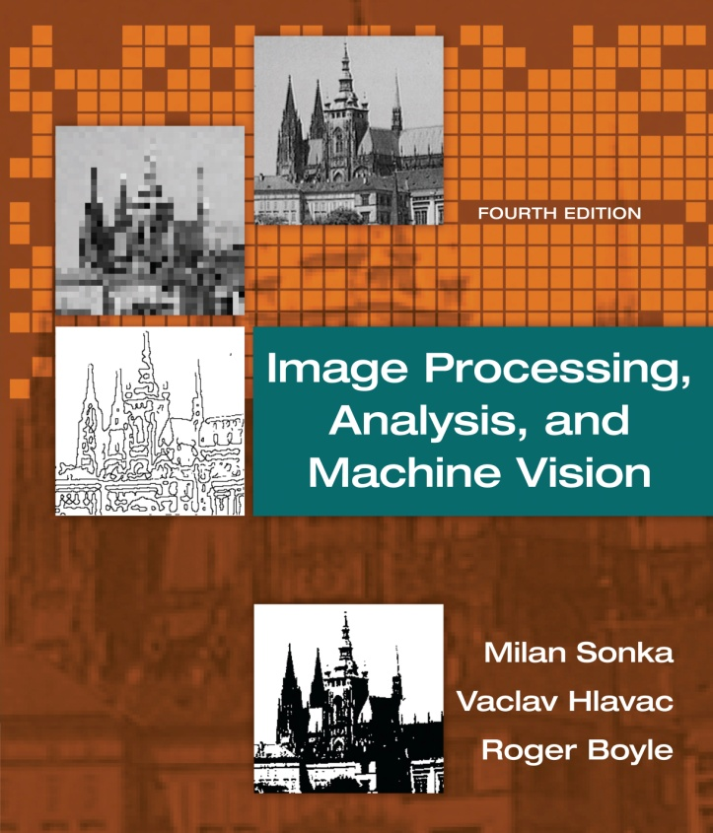

Chapter 2
Image Processing, Analysis, and Machine Vision, 4th Edition Sonka, Hlavac & Boyle
The image, its representations and properties

Slide 2
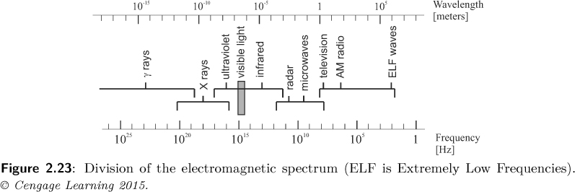
Color images
Image Processing, Analysis, and Machine Vision, 4th Edition Sonka, Hlavac & Boyle
Physics of color
The world is colorless.
Human color perception is carried out by the nervous system (神經系統), which interprets differently to distinct electromagnetic wavelengths (電磁波長 ).
Electromagnetic spectrum (電磁頻譜 )

Slide 3
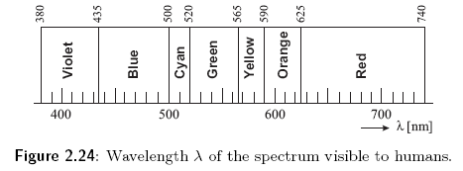
Physics of color
Image Processing, Analysis, and Machine Vision, 4th Edition Sonka, Hlavac & Boyle
Visible spectral colors (可見光譜顏色 )
Colors can be represented as combinations of the primary colors.
Primary colors (原色): red, green and blue
1 nm = 10⁻⁹ m
https://zh.wikipedia.org/wiki/%E5%8E%9F%E8%89%B2

Slide 4
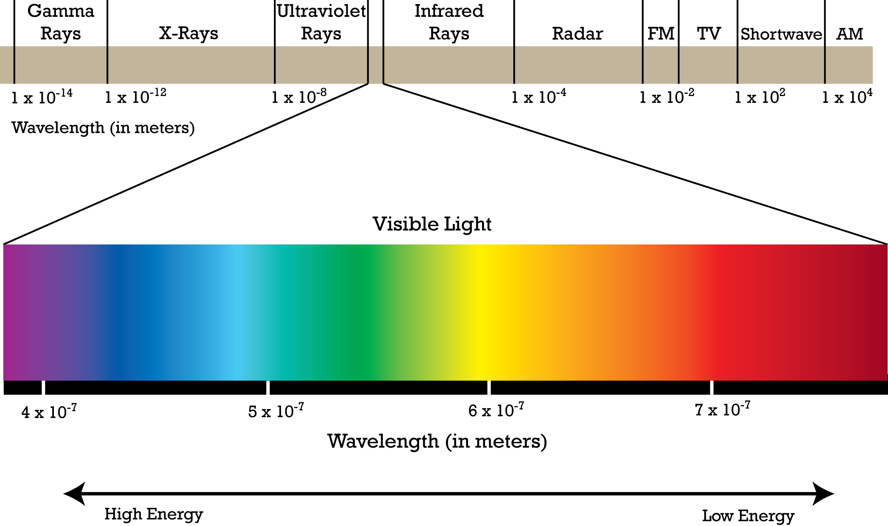
Electromagnetic spectrum

Slide 5
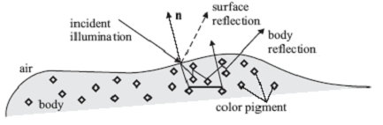
Physics of color
Image Processing, Analysis, and Machine Vision, 4th Edition Sonka, Hlavac & Boyle
Why do we see the world in color?
The surface reflection (表面反射) rebounds (反彈) incoming energy from the surface, whose spectrum remains the same as that of the light source.
It is independent of the surface (do not have a color).
The energy diffuses (漫射) into the material and reflects randomly from the internal pigment (顏料;色素) in the matter. (body reflection)
Observed color of objects is caused by certain wavelength absorptions (吸收) by pigment particles in dielectrics (電介質 ).

Slide 6
Color perceived by humans
Image Processing, Analysis, and Machine Vision, 4th Edition Sonka, Hlavac & Boyle
Retina (視網膜) is composed of photoreceptors (感光器).
Two types of photoreceptors
Rods: sensitive to intensity
Cones: sensitive to color
PS 視桿細胞(rod cell) v.s. 視錐細胞(cone cell)
視桿細胞主要與暗視覺有關( 對光線的明暗變化、形態與移動特別敏感 )，分佈在視網膜周邊部。
視錐細胞則與光視覺有關(用來辨別色彩，並適合偵測各種細節 )，分佈在視網膜中心部，中央小凹( foveola )只有視錐細胞。
PS 眼球構造圖 https://mulicia.pixnet.net/blog/post/4213181

Slide 7
Color perceived by humans
Image Processing, Analysis, and Machine Vision, 4th Edition Sonka, Hlavac & Boyle
Types of cones: L(red), M(green), S(blue)
The figure shows relative sensitivity of S, M, L cones of the human eye to wavelength.
人類每隻眼球視網膜大約600萬~700萬的視錐細胞(cones)，多分布在黃斑處。大多數哺乳動物都具有能感受紅光、藍光以及綠光的三種視錐細胞。
http://cht.a-hospital.com/w/%E8%A7%86%E9%94%A5%E7%BB%86%E8%83%9E
色盲資訊 https://zh.wikipedia.org/wiki/%E8%89%B2%E7%9B%B2
http://blog.fourdesire.com/2014/12/11/wo-he-ni-you-dian-bu-yang-zhen-dui-se-mang-zhe-de-ti-tie-she-ji/

Slide 8
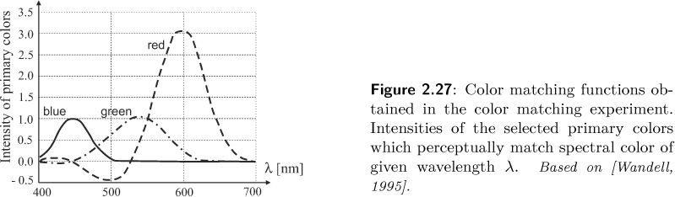
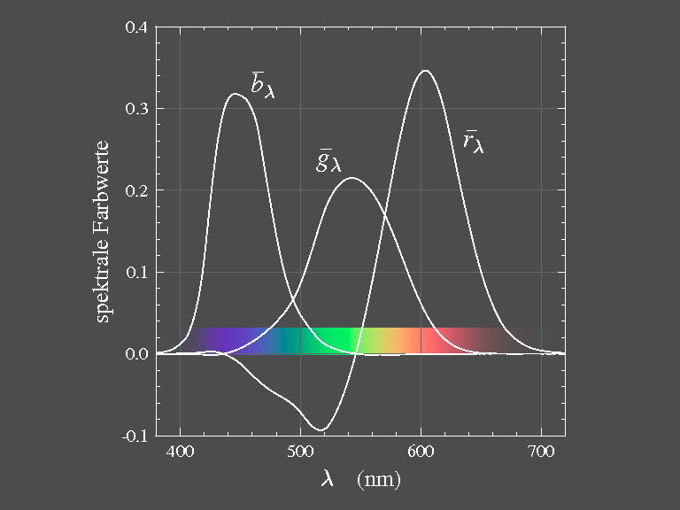
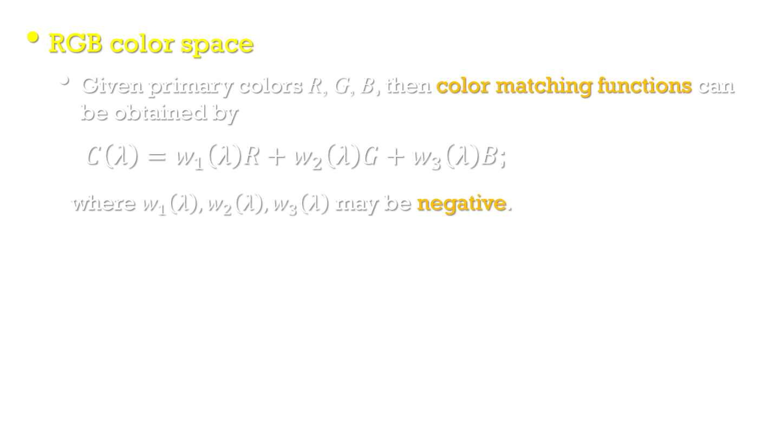
Color perceived by humans
Image Processing, Analysis, and Machine Vision, 4th Edition Sonka, Hlavac & Boyle
RGB color space
Given primary colors R, G, B, then color matching functions can be obtained by
$C\left(λ\right)=w_{1}\left(λ\right)R+w_{2}\left(λ\right)G+w_{3}\left(λ\right)B$;
where $w_{1}\left(λ\right),w_{2}\left(λ\right),w_{3}\left(λ\right)$ may be negative.
https://www.itp.uni-hannover.de/~zawischa/ITP/colmetr.html

Slide 9
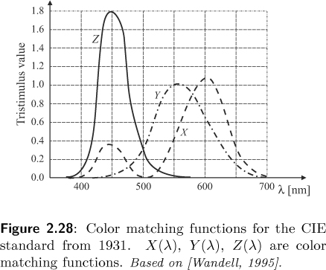
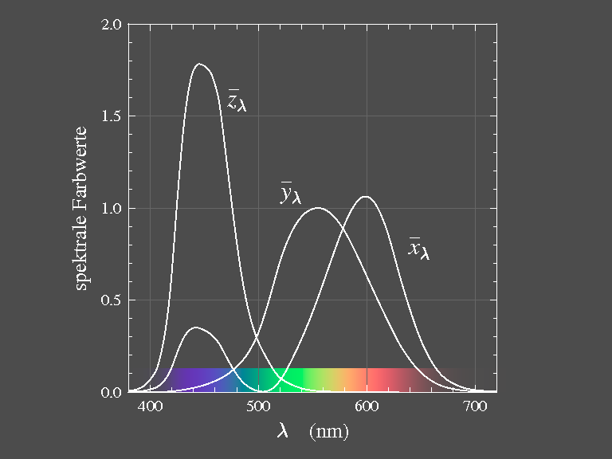
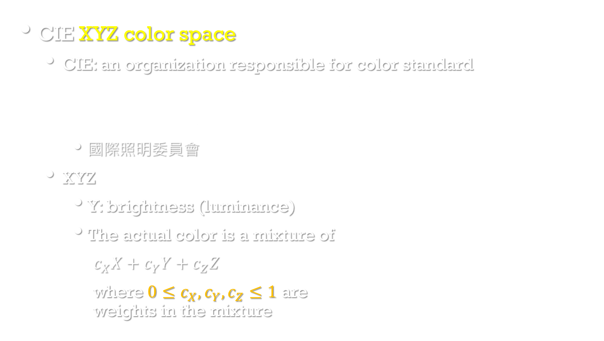
Color perceived by humans
Image Processing, Analysis, and Machine Vision, 4th Edition Sonka, Hlavac & Boyle
CIE XYZ color space
CIE: an organization responsible for color standard
Commission internationale de l'éclairage (French)
International Commission on Illumination
國際照明委員會
XYZ
Y: brightness (luminance)
The actual color is a mixture of
$c_{X}X+c_{Y}Y+c_{Z}Z$
where $0{≤c}_{X},c_{Y},c_{Z}≤1$ are weights in the mixture
CIE XYZ color space
https://zh.wikipedia.org/wiki/CIE1931%E8%89%B2%E5%BD%A9%E7%A9%BA%E9%97%B4

Slide 10
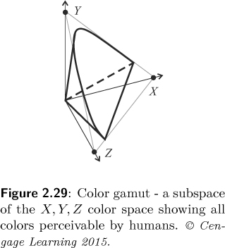
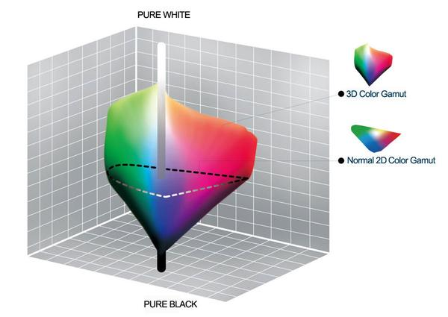
Color perceived by humans
Image Processing, Analysis, and Machine Vision, 4th Edition Sonka, Hlavac & Boyle
Color gamut (色域)
The subspace of colors perceivable by humans is called the color gamut.
https://personalaudio.hk/2017/08/04/colors/

Slide 11
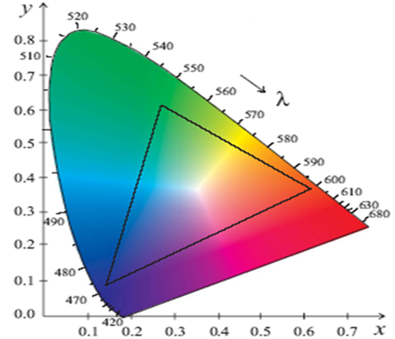
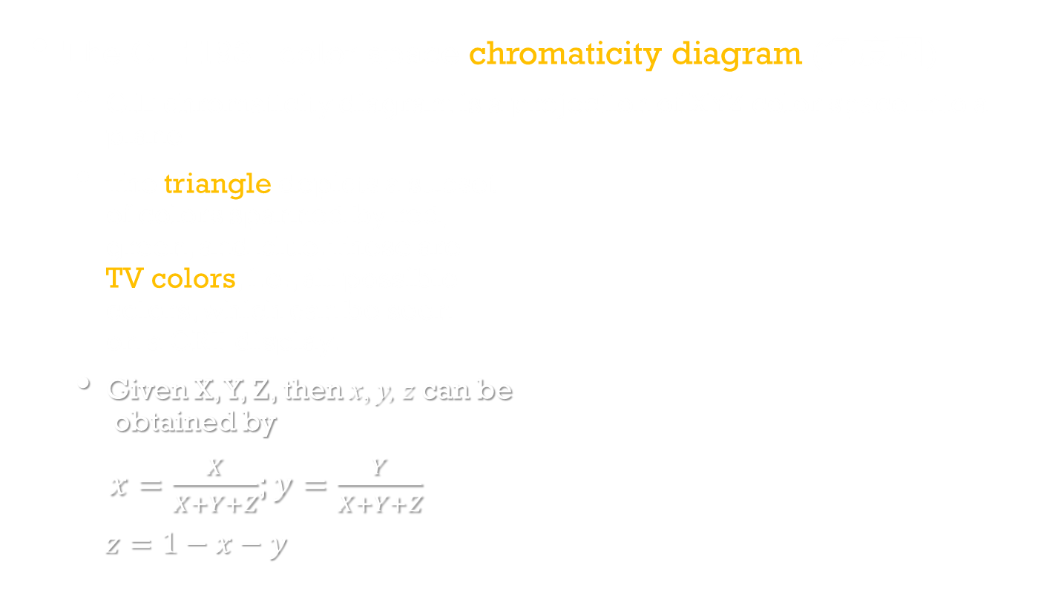
Color perceived by humans
Image Processing, Analysis, and Machine Vision, 4th Edition Sonka, Hlavac & Boyle
The CIE 1931 color space chromaticity diagram (色度圖)
CIE chromaticity diagram is a projection of XYZ color space into a plane.
The triangle depicts a subset of colors spanned by red, green, and blue. These are TV colors, i.e., all possible colors, which can be seen on a CRT display.
Given X, Y, Z, then x, y, z can be obtained by
$x=\frac{X}{X+Y+Z}$; $y=\frac{Y}{X+Y+Z}$
$z=1−x−y$

Slide 12
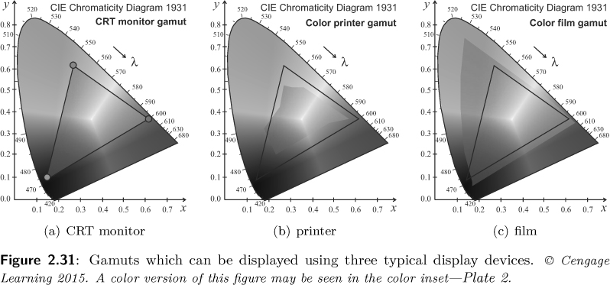
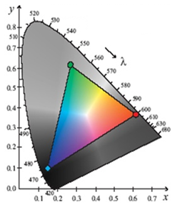
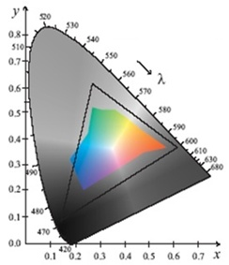
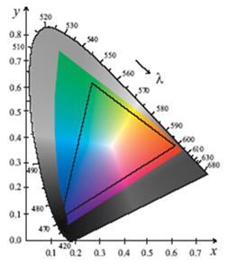
Color perceived by humans
Image Processing, Analysis, and Machine Vision, 4th Edition Sonka, Hlavac & Boyle
Display and printing devices use three selected real primary colors (原色;基色).

Slide 13
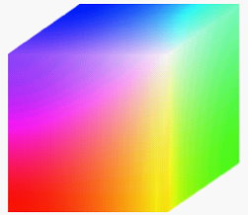
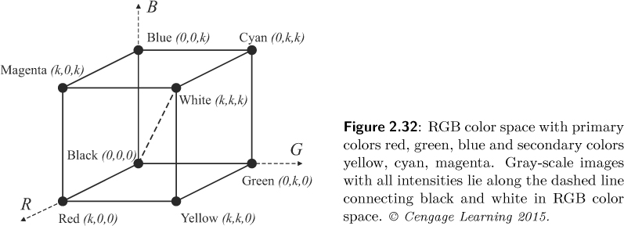
Color spaces
Image Processing, Analysis, and Machine Vision, 4th Edition Sonka, Hlavac & Boyle
RGB color space

Slide 14
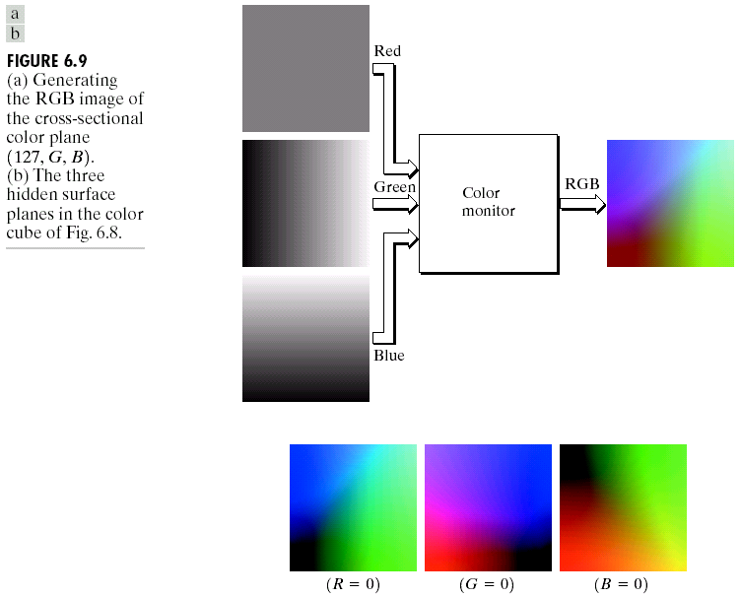
RGB color spaces

Slide 15
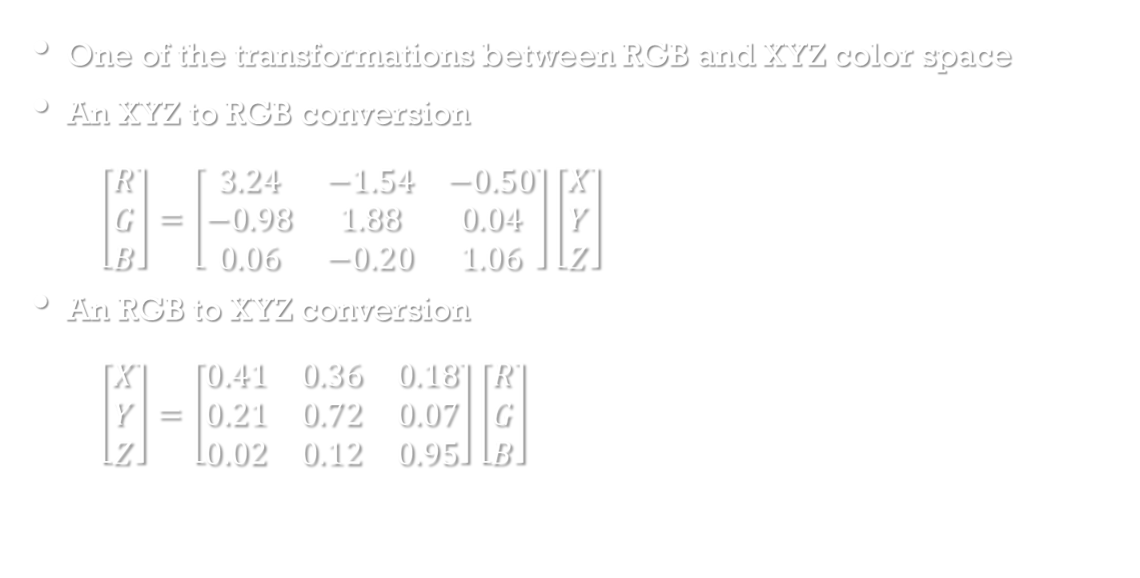
Color spaces
One of the transformations between RGB and XYZ color space
An XYZ to RGB conversion
$\left[\begin{matrix}R \\ G \\ B\end{matrix}\right]=\left[\begin{matrix}3.24 & −1.54 & −0.50 \\ −0.98 & 1.88 & 0.04 \\ 0.06 & −0.20 & 1.06\end{matrix}\right]\left[\begin{matrix}X \\ Y \\ Z\end{matrix}\right]$
An RGB to XYZ conversion
$\left[\begin{matrix}X \\ Y \\ Z\end{matrix}\right]=\left[\begin{matrix}0.41 & 0.36 & 0.18 \\ 0.21 & 0.72 & 0.07 \\ 0.02 & 0.12 & 0.95\end{matrix}\right]\left[\begin{matrix}R \\ G \\ B\end{matrix}\right]$
https://www.rapidtables.com/convert/color/index.html
https://www.w3schools.com/colors/colors_converter.asp

Slide 16
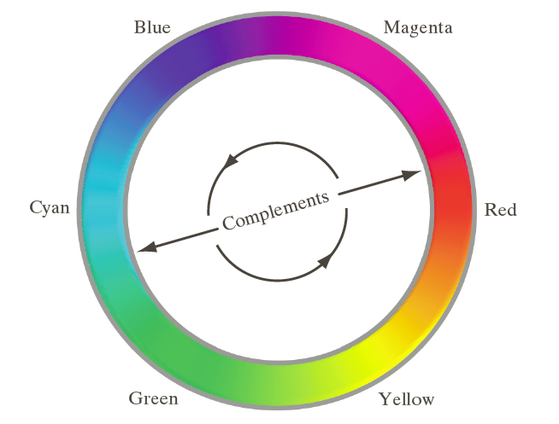
Color spaces
CMY color model uses subtractive color mixing which is used in printing processes.
Cyan (青綠色), magenta (洋紅色), and yellow (黃色) are the secondary colors (二次色) of light of the primary colors (原色) of pigments (顏料).
An RGB to CMY conversion

Slide 17
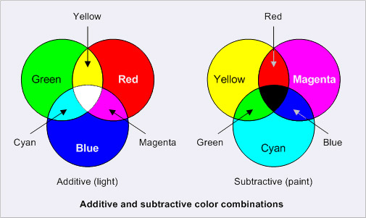
Color spaces
CMYK (K: black) stores ink values for black in addition.
減色法https://zh.wikipedia.org/wiki/%E6%B8%9B%E8%89%B2%E6%B3%95

Slide 18
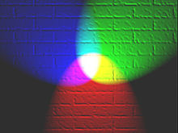
Color Fundamentals
Additive color (加色法)
Subtractive color(減色法)
減色法模型解釋了塗料，染料，墨水和天然色素的混合物產生的顏色，每個顏色會減去（即吸收）某些波長的光並向其他反射。表面所顯示的顏色取決於它反映在電磁波譜的顏色。
加色法是描述那些由不同顏色的光混合形成新顏色的情形。
https://en.wikipedia.org/wiki/Additive_color
https://zh.wikipedia.org/wiki/%E6%B8%9B%E8%89%B2%E6%B3%95
https://zh.wikipedia.org/wiki/%E5%8A%A0%E8%89%B2%E6%B3%95

Slide 19
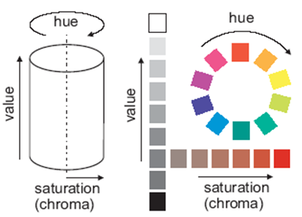
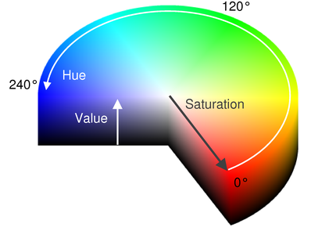
Color spaces
Image Processing, Analysis, and Machine Vision, 4th Edition Sonka, Hlavac & Boyle
HSV color model (Hue, Saturation, and Value)
HSV color model is illustrated as a cylinder.
HSV v.s. HSL: https://en.wikipedia.org/wiki/HSL_and_HSV

Slide 20
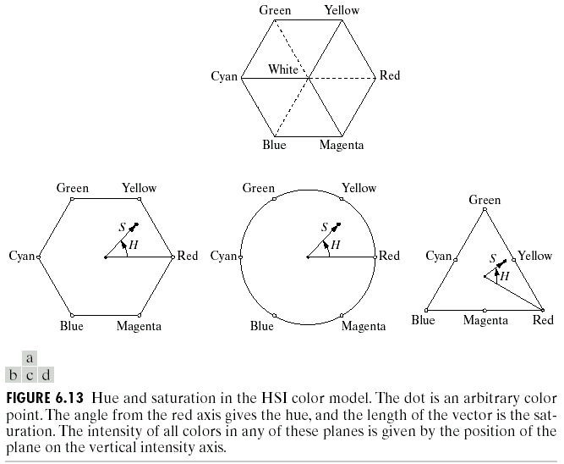
Color Models -- HSI Model
H: Hue
S: Saturation
I: Intensity

Slide 21
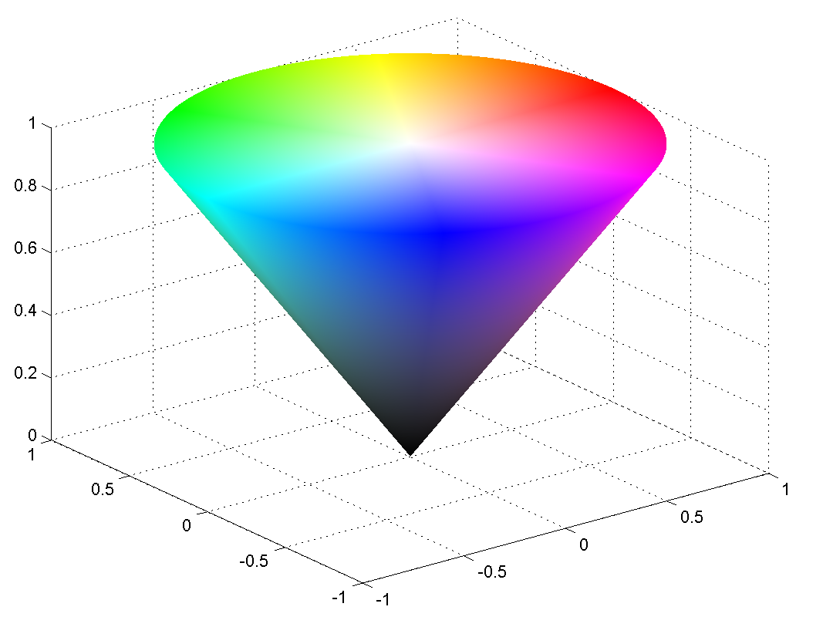
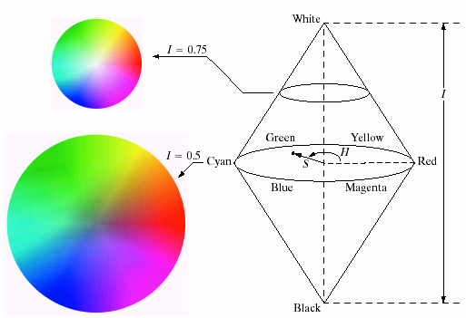
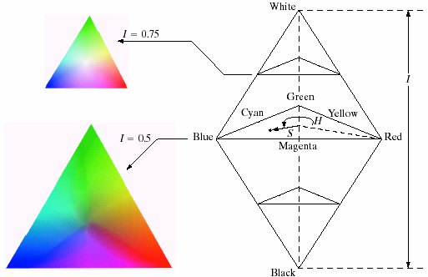
Color Models -- HSI Model
https://nerd.nu/forums/topic/2632-forum-game-google-image-war/?page=7

Slide 22
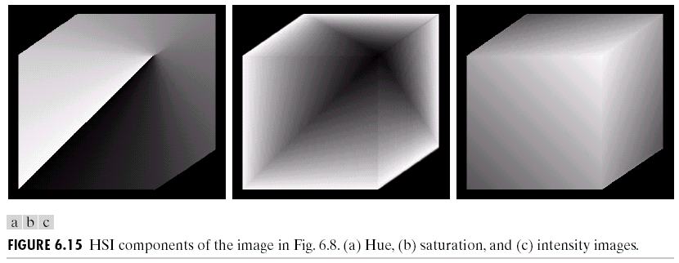


Color Models -- HSI Model
Figure 6.15 shows the hue, saturation, and intensity images for the RGB values shown in Figure 6.8.
H
S
I

Slide 23
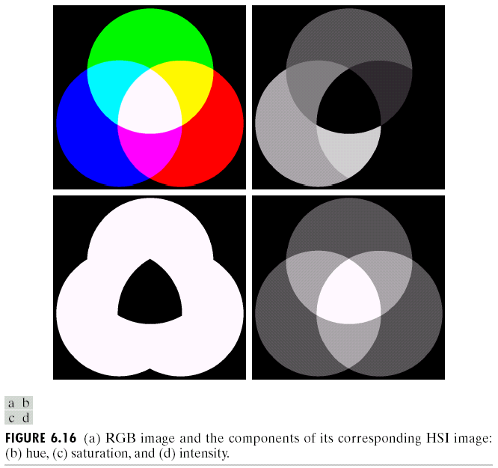
Color Models -- HSI Model
H
S
I

Slide 24
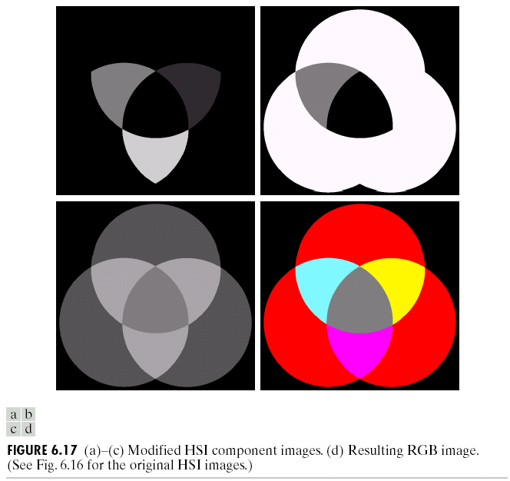
Color Models -- HSI Model
H
S
I

Slide 25
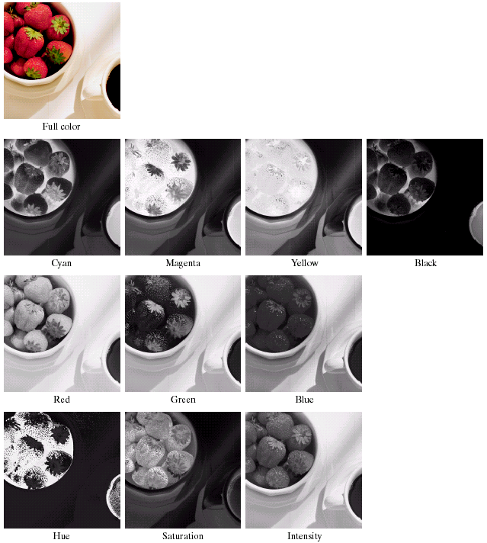
Color Transformations
RGB<->HSI<->CMYK

Slide 26
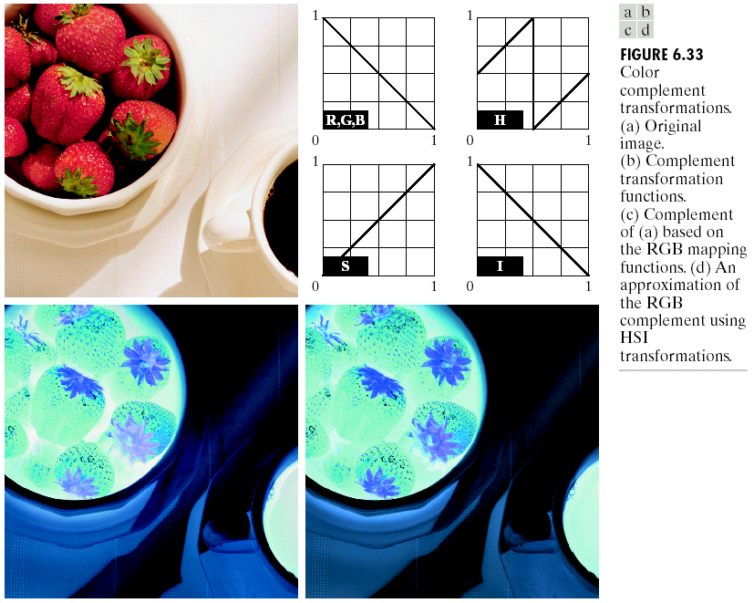
Color Complement Transformations

Slide 27
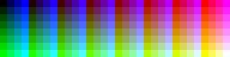
Palette images
Palette images (indexed images;調色板) provide a simple way to reduce the amount of data needed to represent an image.
The pixel values constitute a link to a lookup table (palette; 調色板).
The table contains as many entries as the range of possible values in the pixels which is typically 8 bits (256 values).
For example, (8-bit color, with three bits of red, three bits of green, and two bits of blue)

Slide 28
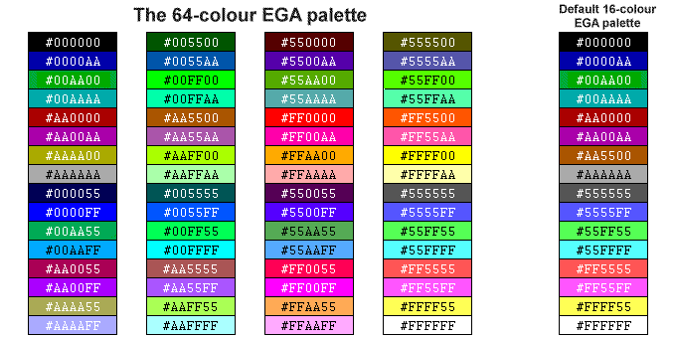
Palette images
http://www.technologyuk.net/computing/computer-systems/display-adapter.shtml

Slide 29
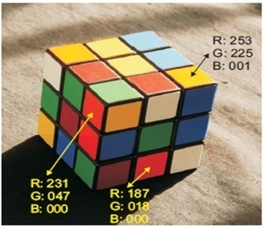
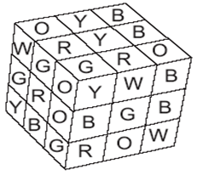
Color constancy
Image Processing, Analysis, and Machine Vision, 4th Edition Sonka, Hlavac & Boyle
Color constancy (顏色恆定)
Surfaces have different colors and brightness when viewed under different lights.
The human vision system is able to abstract to a certain degree from the illumination changes and perceive several instances of a particular color as the same.

Slide 30
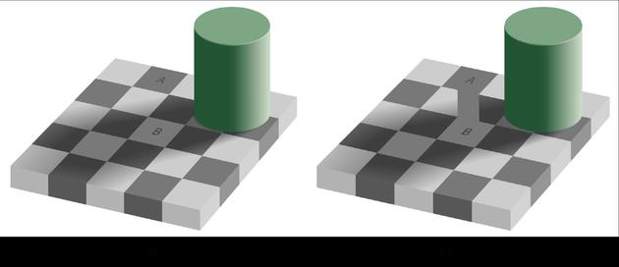
Visual illusions VS Color constancy
https://www.youtube.com/watch?v=-sAoJgJUA8Y
https://www.youtube.com/watch?v=z9Sen1HTu5o

